Slide 1
Cyberbullying Detection Using Support Vector Machine (SVM) Algorithm
A research-based project presented to you by:
F. Ballesteros | P.M. Capuz | J. Juarez | S. Mallari | E. Samillano

Slide 2
Cyberbullying IN the philippines
a form of harassment that occurs via the Internet which includes vicious forum posts, name calling in chat rooms, creating fake profiles on social networking sites, and sending cruel messages
Notes:
- Place definitions of cyberbullying from different people (experts) and add the team’s own definition of it based from the gathered resources

Slide 3
How do social media platforms deal with cyberbullying?
Privacy Settings
Reporting Tools
YouTube’s Safety Mode
Twitter’s Mute Feature
Notes:
- Place definitions of cyberbullying from different people (experts) and add the team’s own definition of it based from the gathered resources

Slide 4
Research problem and opportunity
Problem to be tackled
Brief overview of the research
Brief overview of the proposed software
Notes:
- Place definitions of cyberbullying from different people (experts) and add the team’s own definition of it based from the gathered resources

Slide 5
Statement of the Problem
How can the current process of identifying and reporting cyberbullying occurrences online be improved?

Slide 6
Objective
Main Objective
This project aims to improve the current, manual processes of identifying and reporting cyberbullying occurrences online by developing a cyberbullying detection system

Slide 7
Objective
Specific Objectives
To research concepts regarding the development of the cyberbullying detection system
To gather textual data for the corpus
To perform text preprocessing methods on the dataset
To perform text annotation on the dataset
To implement machine learning algorithm using WEKA

Slide 8
Objective
Specific Objectives
To generate a cyberbullying detection model
To develop a cyberbullying detection system
To test the accuracy of the system in terms of identifying and reporting cyberbullying statements
To document all processes performed

Slide 9
Scope and Limitations
Manual processes to be improved: enabling of privacy settings, accessibility of a reporting tool page, introduction of “Safety Mode” (YouTube) and “Mute” (Twitter), and the creation of a moderation and profanity blocklist (Facebook)
Main concepts that were researched on: text classification, Support Vector Machine (SVM) algorithm, related literature and studies, and requirements needed by the system
Corpus: All 2000 statements were extracted from public, controversial posts in Twitter, Facebook, and Youtube

Slide 10
Scope and Limitations
Text preprocessing methods: cleaning of the dataset, tokenization, and conversion of the data to Bag-of-words
Cleaning of the dataset: removing special characters, non-readable text, emoticons, links, and foreign language characters
The annotation schemes used are the following: cyberbullying, not cyberbullying, and ambiguous cyberbullying
The machine learning algorithm that was implemented is the Support Vector Machine (SVM) algorithm

Slide 11
Scope and Limitations
Cyberbullying detection model was designed to analyze and classify public posts that were written only in Filipino, as to how it is utilized in Metro Manila
The system will be tested using Asia Pacific College’s adapted provisions

Slide 12
Scope and Limitations
System will be programmed using Java
The documentation will follow the official format given by the school

Slide 13
Significance
To Filipino social media users
To the researchers
To cyberbullying advocates
To the students of Asia Pacific College
To the members of the Office of the Student Affairs of APC

Slide 14
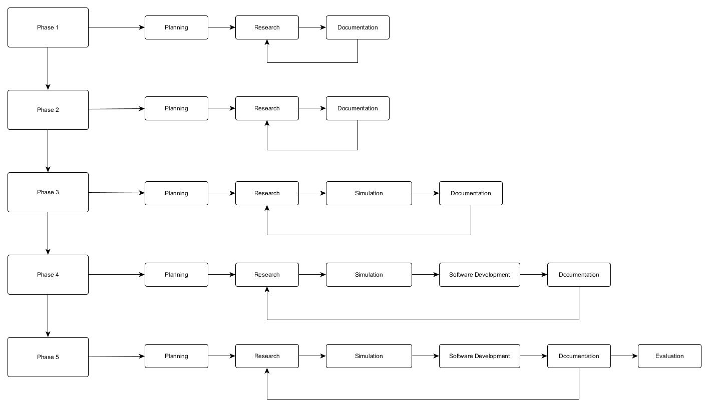
Software development life cycle
Notes:
- Place definitions of cyberbullying from different people (experts) and add the team’s own definition of it based from the gathered resources

Slide 15
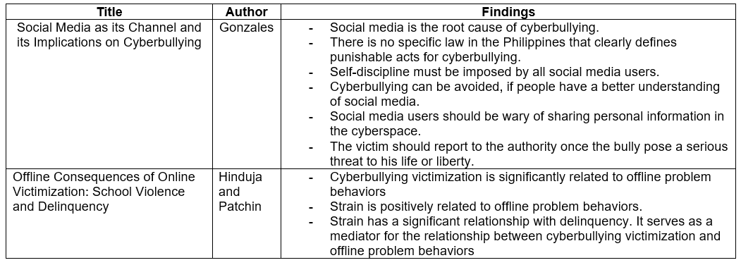
Review of Related Literature

Slide 16
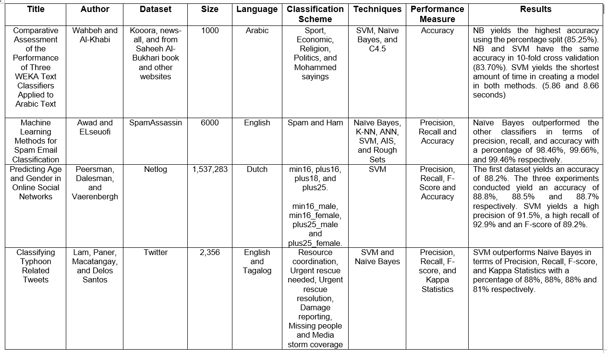

Slide 17
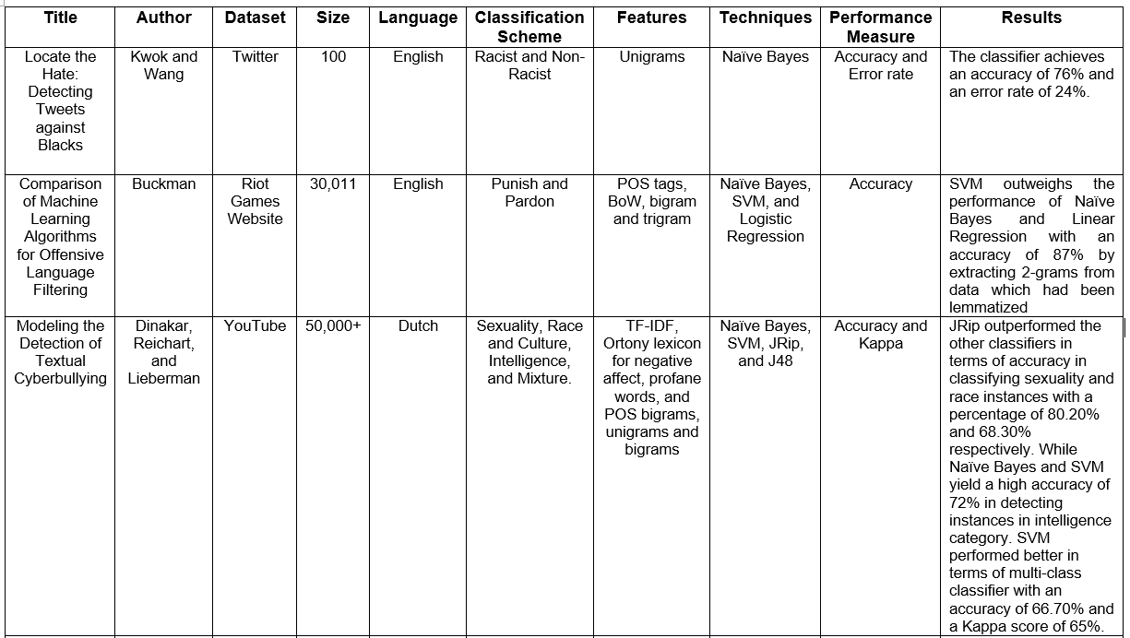

Slide 18
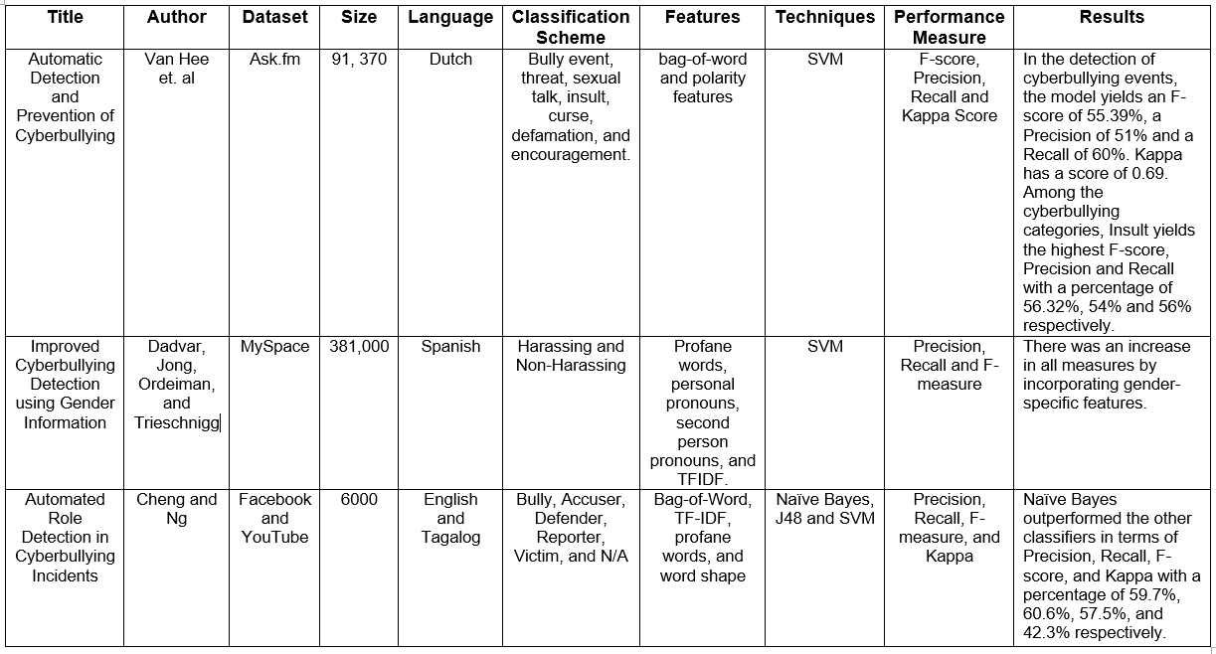

Slide 19
Theoretical Background
Audience Segregation
Introduced by Ervin Goffman
It describes how people play different roles in different situations.
It is a mechanism wherein an individual perform roles, in order to create a favorable image of themselves and leave a good impression to others that is linked to the role they perform.
The role that the individual performs is based on who their audience is.

Slide 20
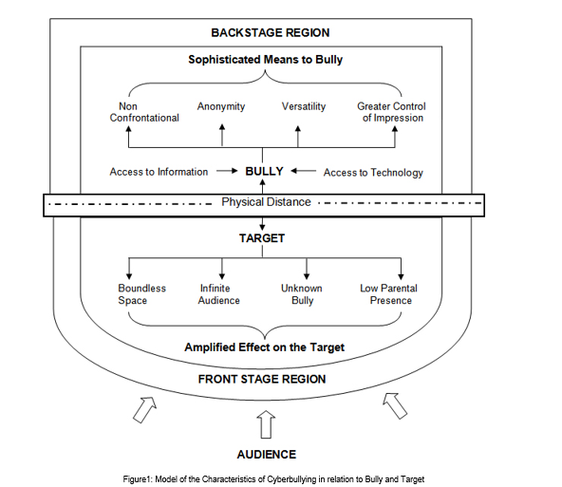
Audience Segregation by Ervin Goffman

Slide 21
Theoretical Background
Text Classification
Classifies document into predefined categories
The document can either be found in a single, multiple, or no category.
With the aid of Machine Learning, the process of text classification can be automated

Slide 22
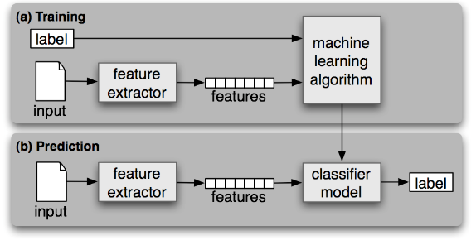
Statistical Text Classification

Slide 23
Theoretical Background
One of the most commonly used linear model
SVM performs classification by creating a k-dimensional hyperplane that separates the data into two categories.
It is a non-probabilistic binary linear classifier
Support Vector Machine

Slide 24
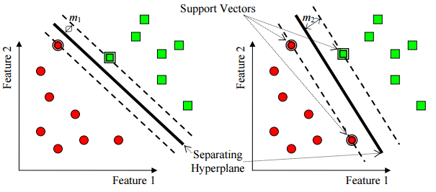
Support Vector Machine (SVM)

Slide 25
Theoretical Background
Bag of Words (BoW) Model
The goal is to create a numeric representation for the data.
It is defined as an order less document representation
A word in a document is assigned a weight according to its frequency in the document and frequency in between different documents.

Slide 26
Theoretical Background
Performance Measures
Most evaluation for the text classifier is conducted experimentally
It is used to measure its effectiveness or the quality of its predictions on the classification of data

Slide 27
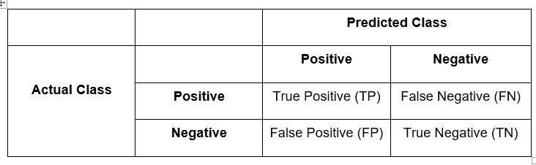
Confusion Matrix

Slide 28

Theoretical Background
Precision
Precision is used to measure the exactness of the classifier
It is also called positive predictive value (PPV)

Slide 29

Theoretical Background
Recall
It is used to measure the completeness of a classifier.
Moreover, it is also called the true positive rate or sensitivity.

Slide 30

Theoretical Background
The accuracy is the percentage of instances that were correctly classified into their respective classes.
It is also called sample accuracy.
It may yield to misleading result if the dataset is unbalanced
Accuracy

Slide 31

Theoretical Background
F-Measure
The F-measure (or F-score) is used to measure the accuracy of the test by considering both precision and recall in computing the score.

Slide 32

Theoretical Background
Kappa Statistics
The calculation is based on the difference between the numbers of agreement that are actually present compared to the numbers of agreement that would be expected to be present by chance.

Slide 33

System application
QuickGarde
“the number one solution for cyber bullying occurrences in the Philippines”

Slide 34
System objectives
Main Objective
The system’s main purpose is to be able to detect statements that contain cyberbullying elements and procure reports accordingly.
Specific Objectives
Automate processes included in the research conducted
Automate the process of moderating social media sites
Detect cyberbullying occurrences
Flag all detected cyberbullying occurrences
Automatically produce timely and organized reports

Slide 35
System Scope and Limitation
Detection will only work in two languages – English and Tagalog
Detection is limited only to text
The algorithm to be used is Support Vector Machine (SVM) algorithm (deployed through WEKA)
The software will be programmed in Java

Slide 36
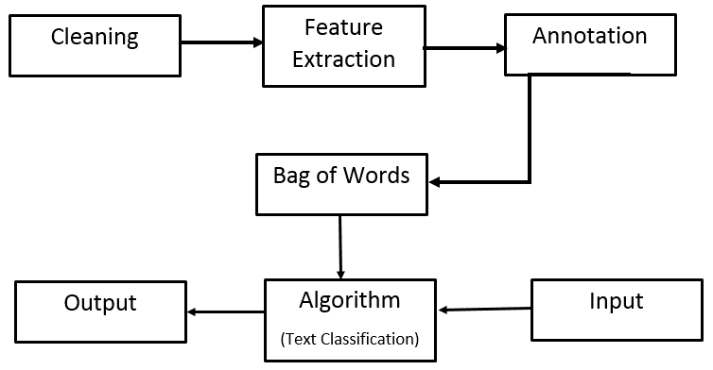
Processes from Last Term

Slide 37
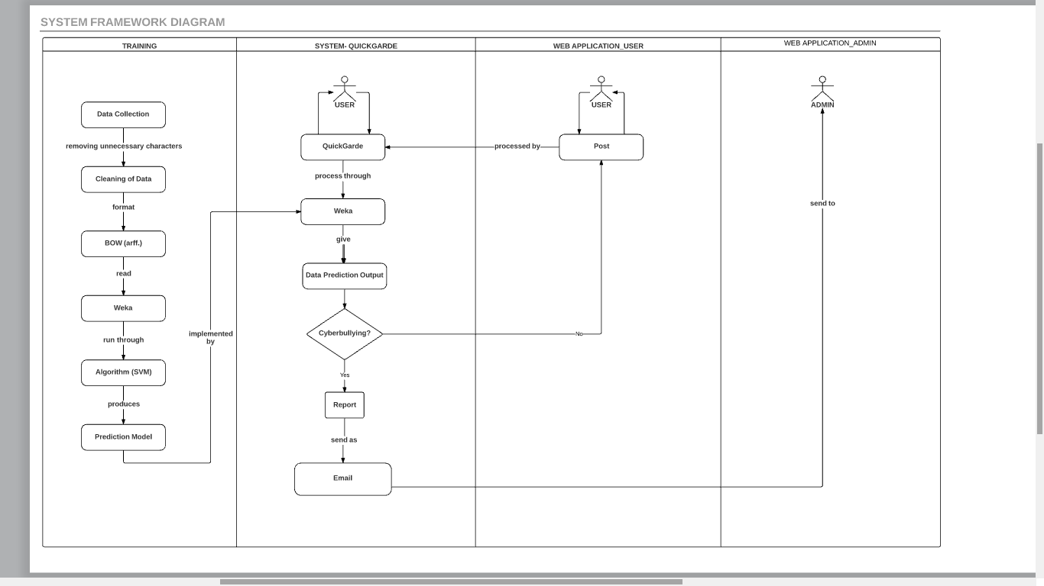
System Framework Diagram

Slide 38





Design and Methodology
Software Applications Used

Slide 39
Experimentation phase
Data Corpus
Preprocessing
Cleaning of the dataset
Tokenization
Data Annotation
Bag of Words
Support Vector Machine

Slide 40


Design and Methodology
Preprocessing
-Cleaning of the dataset
-Tokenization

Slide 41
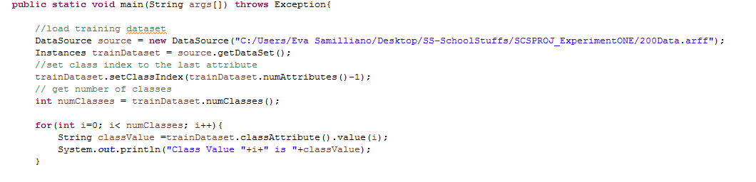
-Bag of Words (.arff)
Term-Frequency Value
Weka

Slide 42

-Support Vector Machine

Slide 43
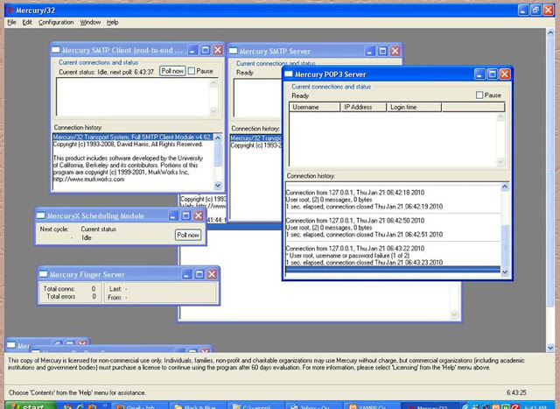
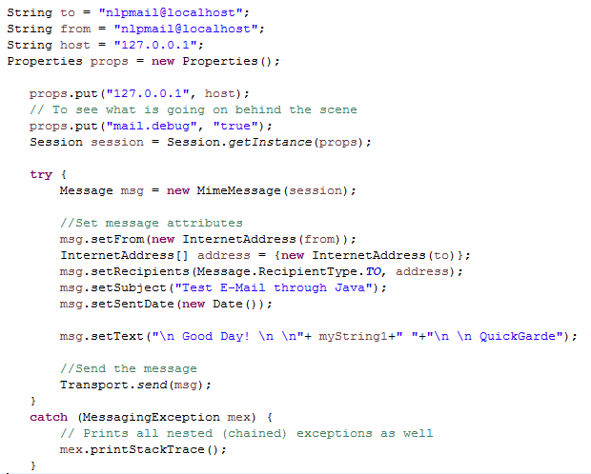
Additionally
-Sending mail from Localhost with XAMPP and mercury/32

Slide 44
Video Presentation
QuickGarde – The System Application Demo

Slide 45
Future Works
We are planning to extend the scope of the Quickgarde system by integrating it to a dummy social networking site as a website add-in.
Moreover, the report generation will be further enhanced by creating a web application for the admin, wherein he can view the reports in an organized tabular format which includes the name of the person who authored the post, the content of the post, and the time and date it was posted.
We also aim to improve the classifier’s accuracy by adding more data to the corpus and performing additional preprocessing steps such as stemming and lemmatization.

